Slide 1
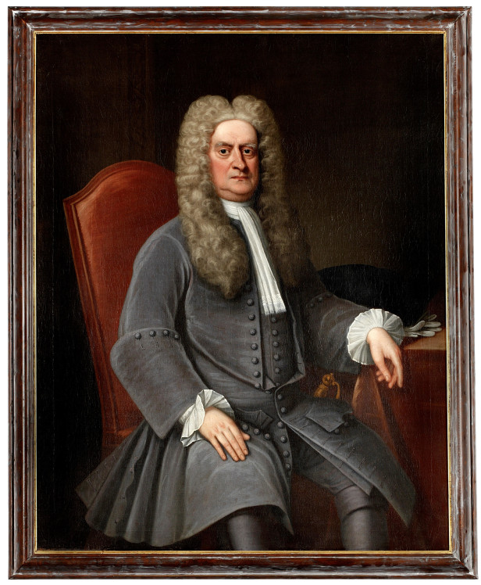
Newton’s Laws - חוקי ניוטון

Slide 2
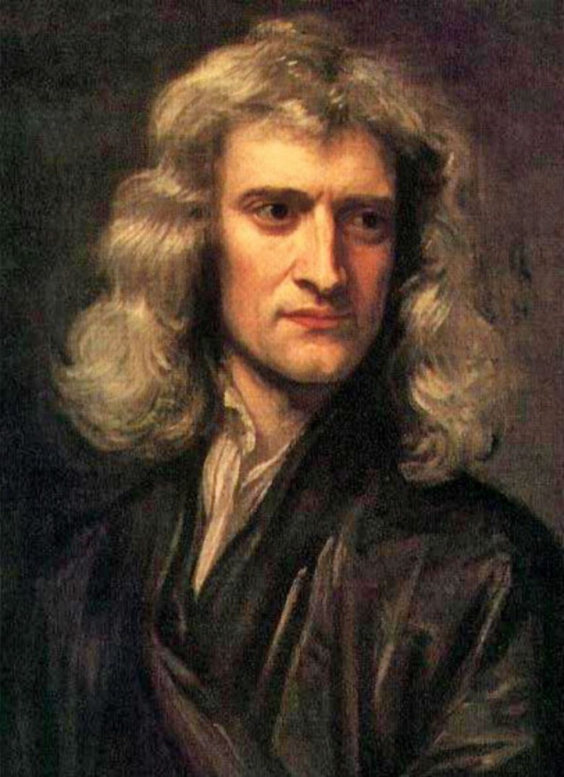
Isaac Newton
אייזק ניוטון

Slide 3
עקרון ההתמדה
principle of inertia

Slide 4
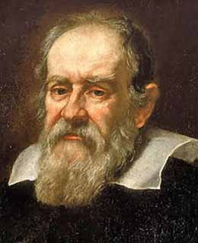
גלילאו גליליי
Galileo Galilei

Slide 5
מערכת ייחוס אינרציאלית
היא מערכת שביחס אליה גוף אשר לא פועל עליו כוח ינוע בקו ישר ובמהירות קבועה.
inertial frame of reference

Slide 6
Shut yourself up with some friend in the main cabin below decks on some large ship, and have with you there some flies, butterflies, and other small flying animals. Have a large bowl of water with some fish in it; hang up a bottle that empties drop by drop into a wide vessel beneath it. With the ship standing still, observe carefully how the little animals fly with equal speed to all sides of the cabin. The fish swim indifferently in all directions; the drops fall into the vessel beneath; and, in throwing something to your friend, you need throw it no more strongly in one direction than another, the distances being equal; jumping with your feet together, you pass equal spaces in every direction. When you have observed all these things carefully (though doubtless when the ship is standing still everything must happen in this way), have the ship proceed with any speed you like, so long as the motion is uniform and not fluctuating this way and that. You will discover not the least change in all the effects named, nor could you tell from any of them whether the ship was moving or standing still. In jumping, you will pass on the floor the same spaces as before, nor will you make larger jumps toward the stern than toward the prow even though the ship is moving quite rapidly, despite the fact that during the time that you are in the air the floor under you will be going in a direction opposite to your jump. In throwing something to your companion, you will need no more force to get it to him whether he is in the direction of the bow or the stern, with yourself situated opposite. The droplets will fall as before into the vessel beneath without dropping toward the stern, although while the drops are in the air the ship runs many spans. The fish in their water will swim toward the front of their bowl with no more effort than toward the back, and will go with equal ease to bait placed anywhere around the edges of the bowl. Finally the butterflies and flies will continue their flights indifferently toward every side, nor will it ever happen that they are concentrated toward the stern, as if tired out from keeping up with the course of the ship, from which they will have been separated during long intervals by keeping themselves in the air. And if smoke is made by burning some incense, it will be seen going up in the form of a little cloud, remaining still and moving no more toward one side than the other. The cause of all these correspondences of effects is the fact that the ship's motion is common to all the things contained in it, and to the air also. That is why I said you should be below decks; for if this took place above in the open air, which would not follow the course of the ship, more or less noticeable differences would be seen in some of the effects noted.

Slide 8
עקרון היחסות של גלילאו
אין דרך פיזיקלית להבדיל בין גוף הנע במהירות קבועה לבין גוף נח.
=
חוקי הפיזיקה זהים
במערכות אינרציאליות.

Slide 9
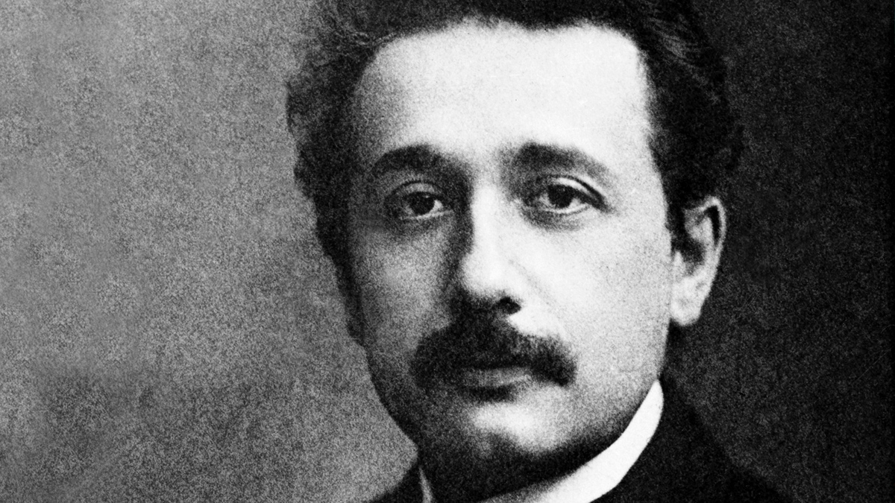
תורת היחסות
1. עקרון היחסות של גלילאו
2. מהירות האור קבועה לכל המערכות האינרציאליות.

Slide 11
$$\vec{a}=\frac{\vec{F}}{m}$$

Slide 13
החוק השני מגדיר מהי מסה.
$$m=\frac{\vec{F}}{\vec{a}}$$
מסה היא ״כמות החומר״ של גוף.
מסה היא מדד לאינרציה של גוף!
(להתנגדות שלו לתאוצה)

Slide 15
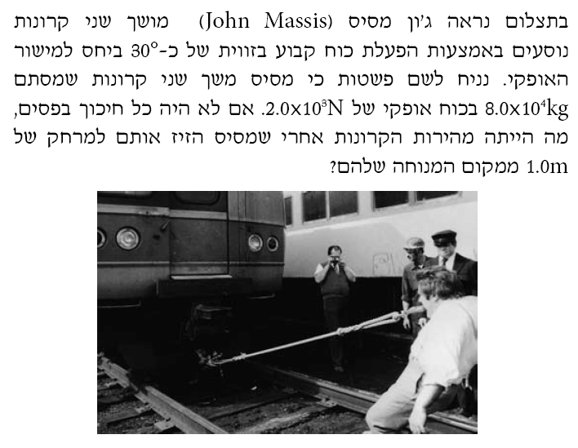

Slide 20
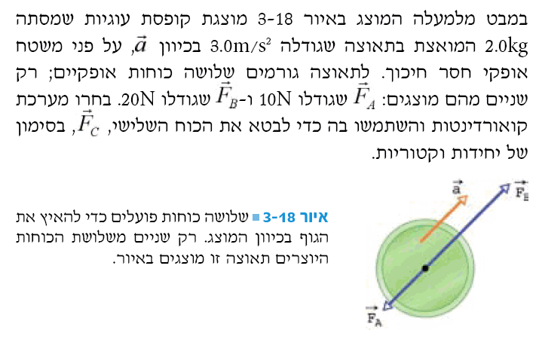

Slide 21
